Slide 1
Prisoner or Citizen
Andres Felipe Vargas

Slide 2
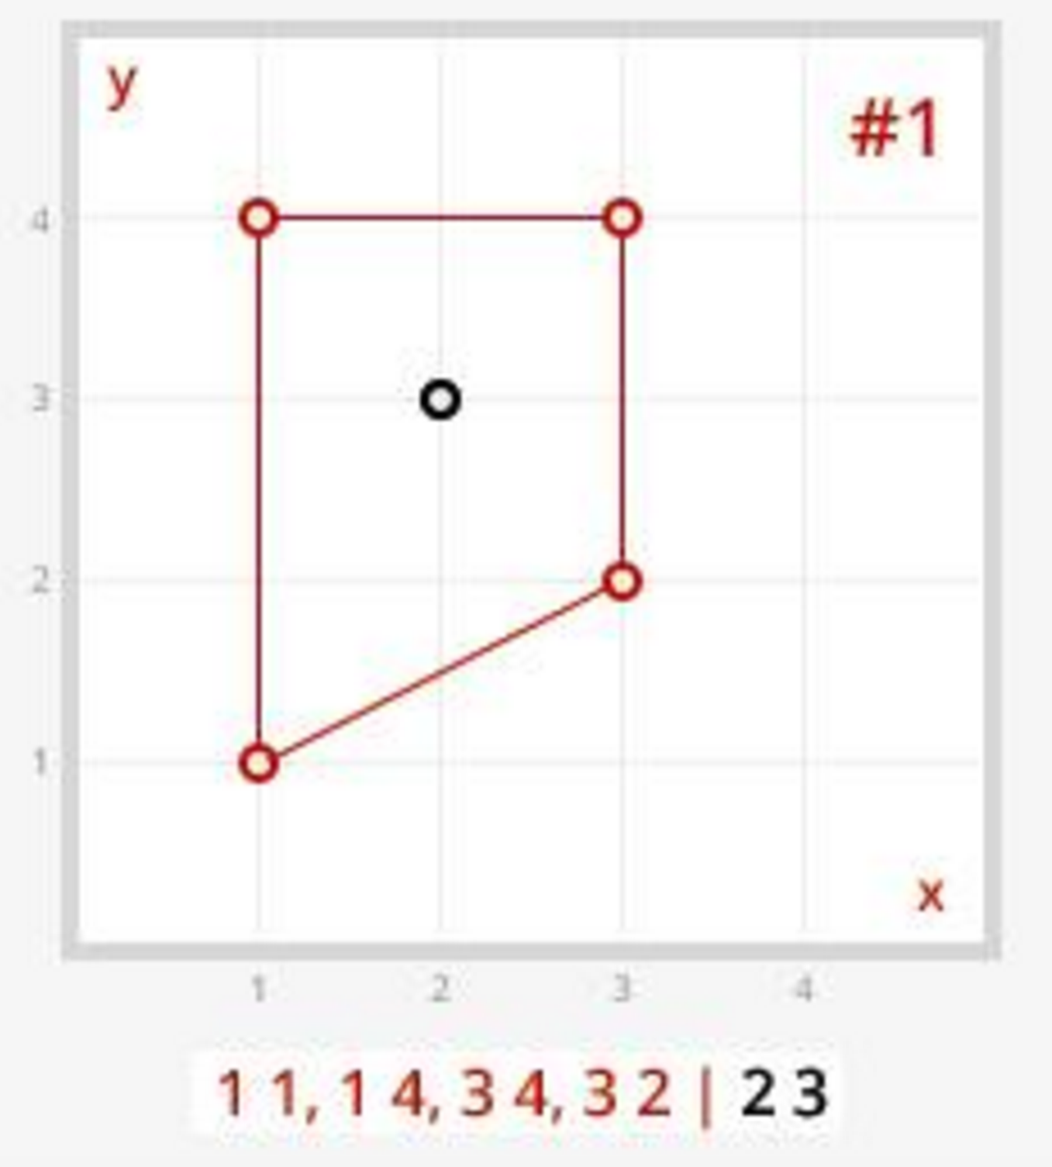
Problem description
There is a person that is located somewhere in the world.
There is a prison with specific coordinates that is located somewhere in the same world.
The prison could be any shape, it is dependent on the coordinates.
Find out if the person is a prisoner ( they are inside of the prison) or is a citizen.

Slide 3
Problem Analysis
How to find out if the person is inside of the prison
If they are found on any of they walls, they are prisoners
Check the status of the person as the prison is created
Check to see if the person is to the Clockwise or Counter-Clockwise of the prison walls as they are being generated
This is direction dependent
Computational Geometry
Use Right Hand Rule
If by the end of the prison creation, the person was equally to the Clockwise and Counter-Clockwise of the walls, then they are outside of the prison

Slide 4
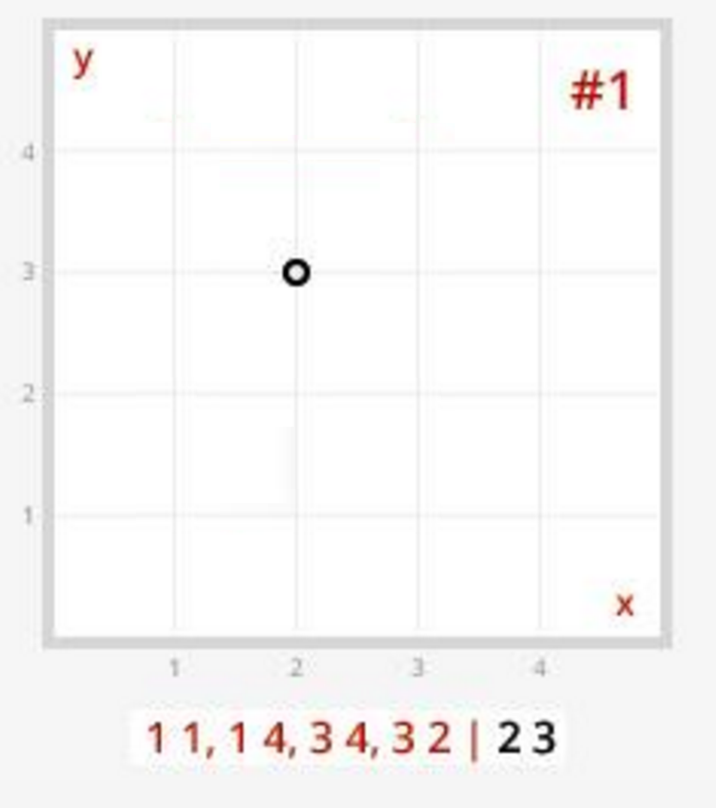
Creating the prison
Coordinates
Prison | Person
Prison Coordinates
Split the coordinates into a list of tuples

Slide 5
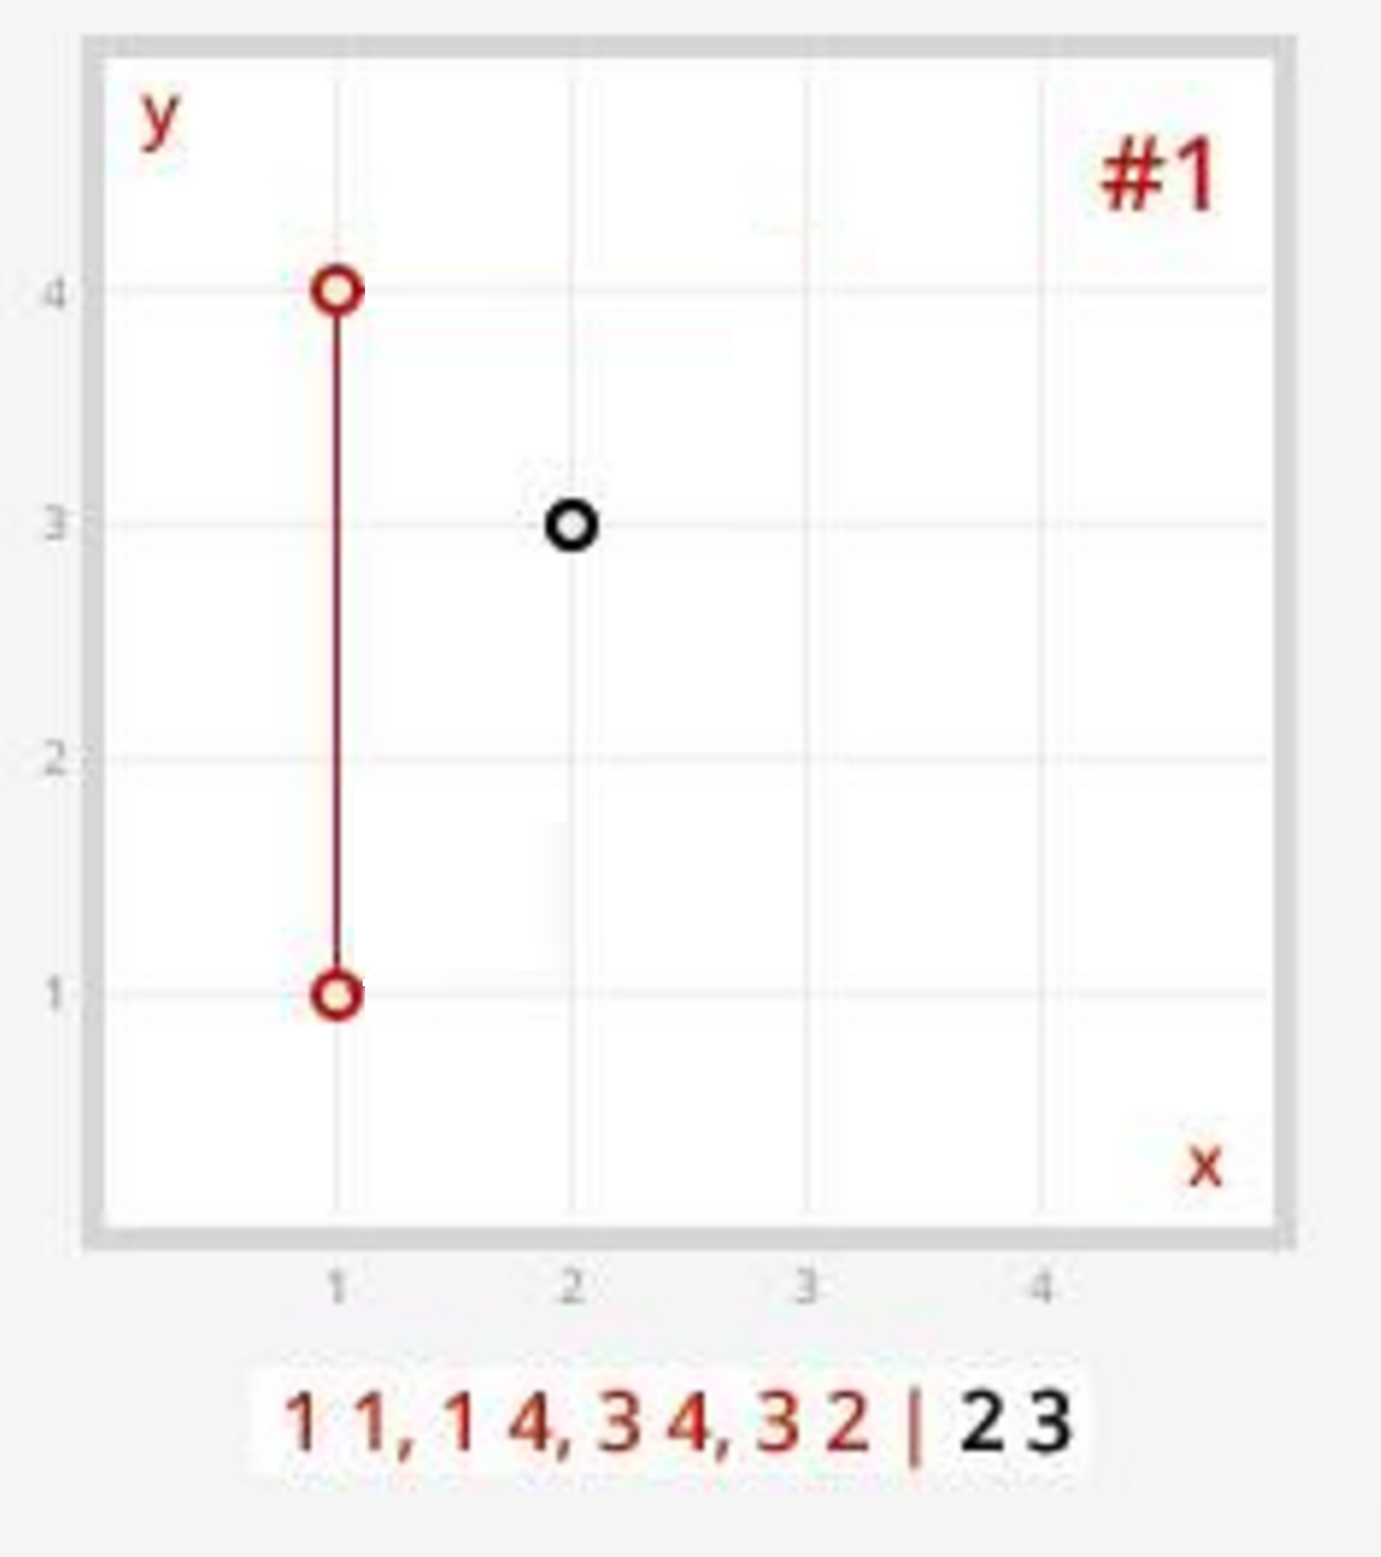
Creating the prison
Creating the first wall
(1,1)
(1,4)
Person
(2,3)
Side of wall
Clockwise: 0
Counter-Clockwise: 0

Slide 6
Creating the prison
Creating the first wall
(1,1)
(1,4)
Person
(2,3)
Side of wall
Clockwise: 1
Counter-Clockwise: 0

Slide 7
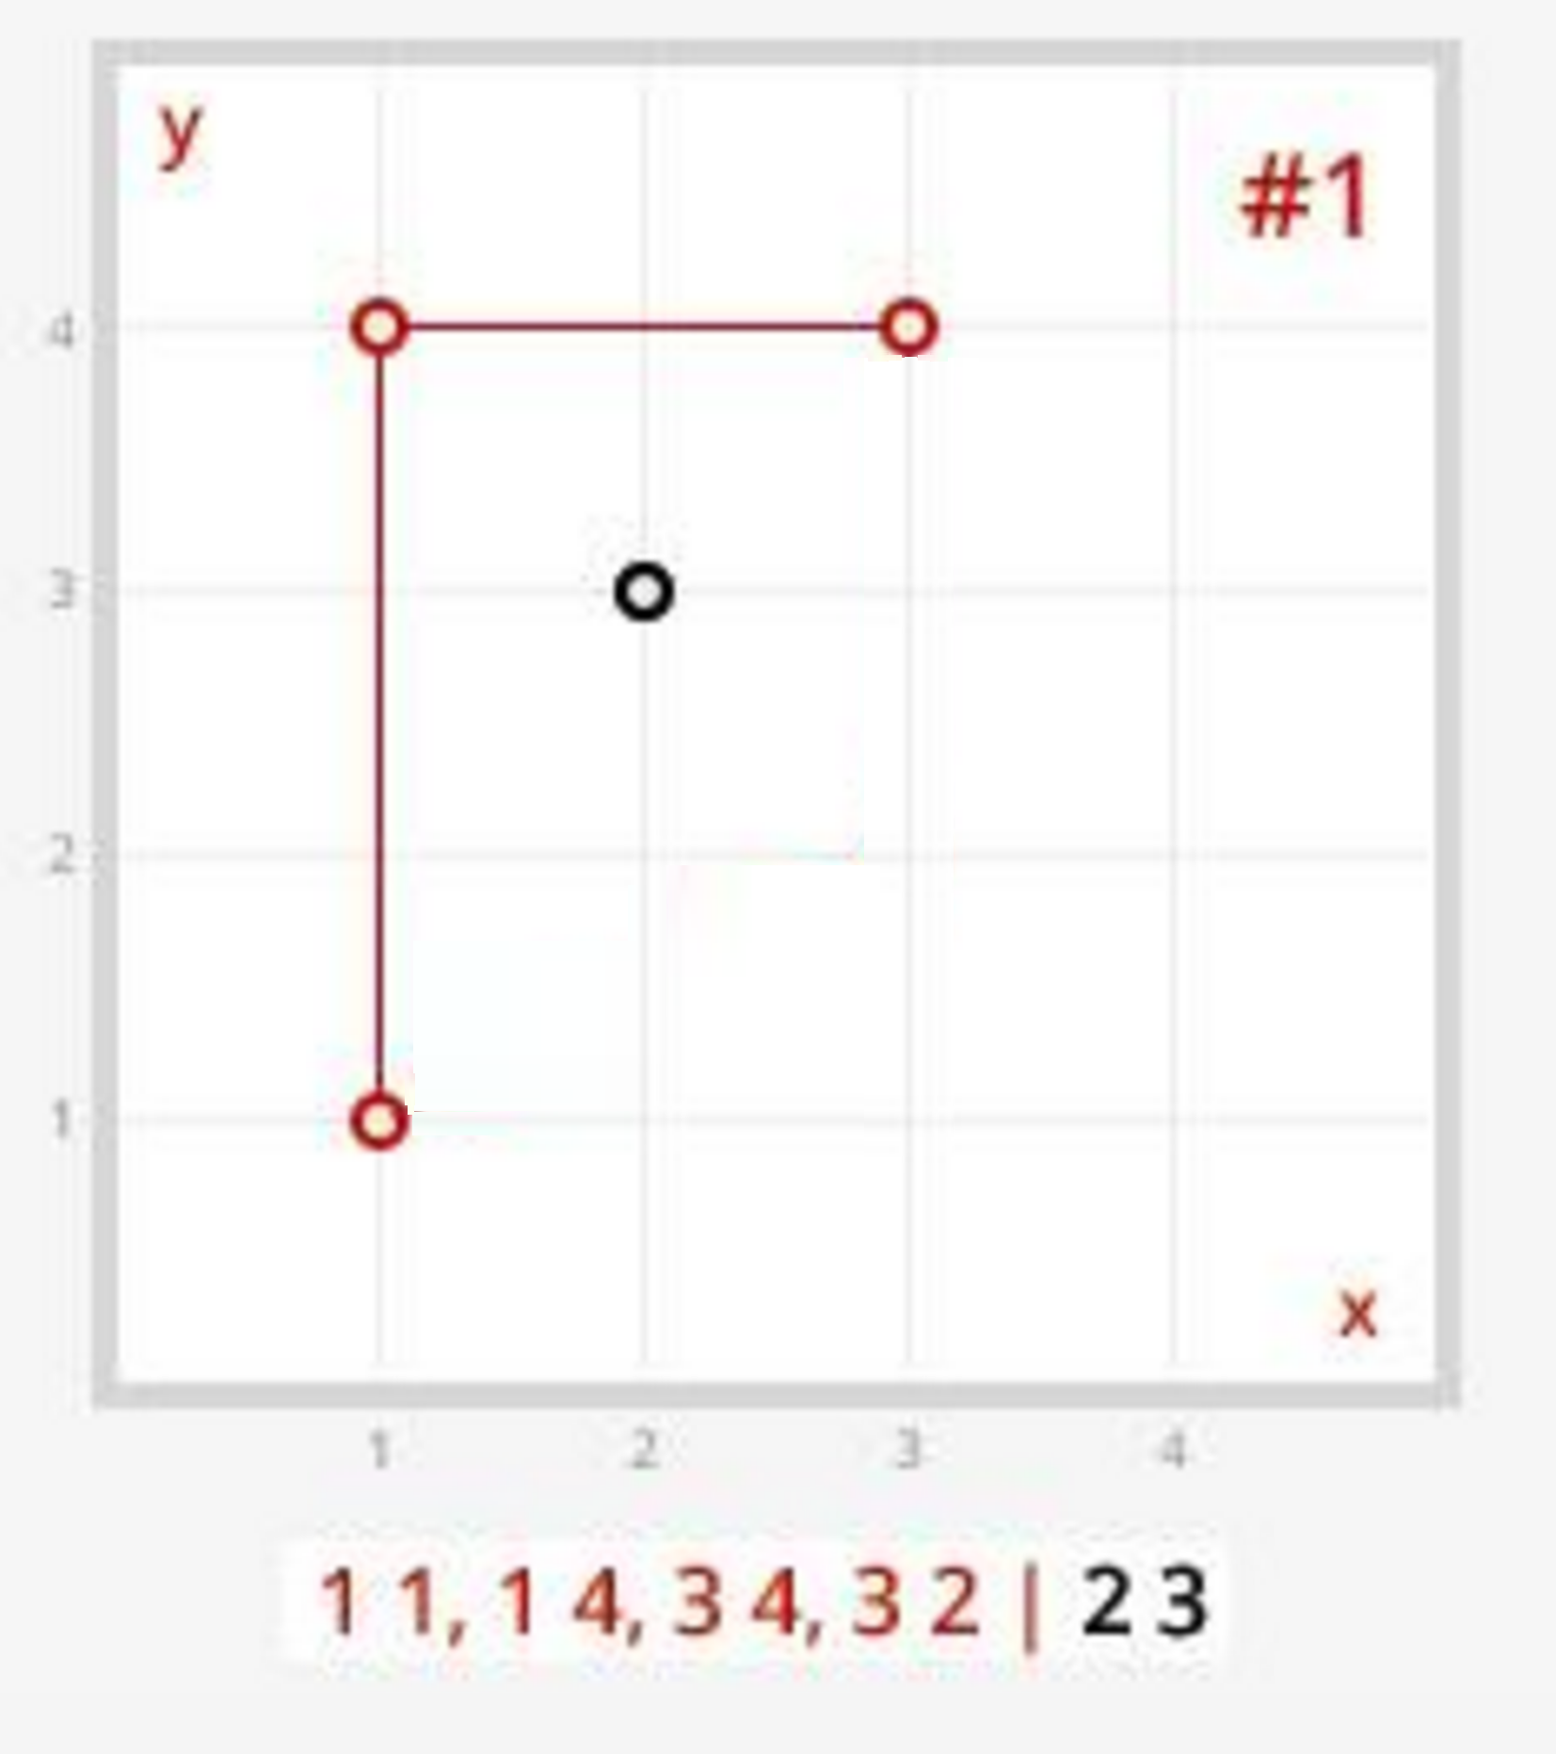
Creating the prison
Creating the first wall
(1,4)
(3,4)
Person
(2,3)
Side of wall
Clockwise: 1
Counter-Clockwise: 0

Slide 8
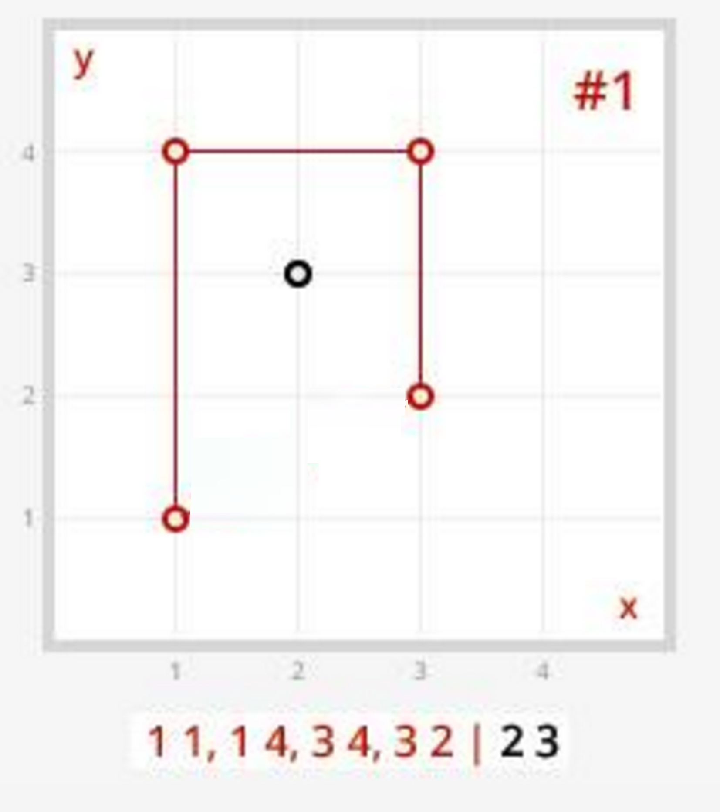
Creating the prison
Creating the first wall
(3,4)
(3,2)
Person
(2,3)
Side of wall
Clockwise: 1
Counter-Clockwise: 0

Slide 9
Creating the prison
Creating the first wall
(3,4)
(3,2)
Person
(2,3)
Side of wall
Clockwise: 2
Counter-Clockwise: 0

Slide 10
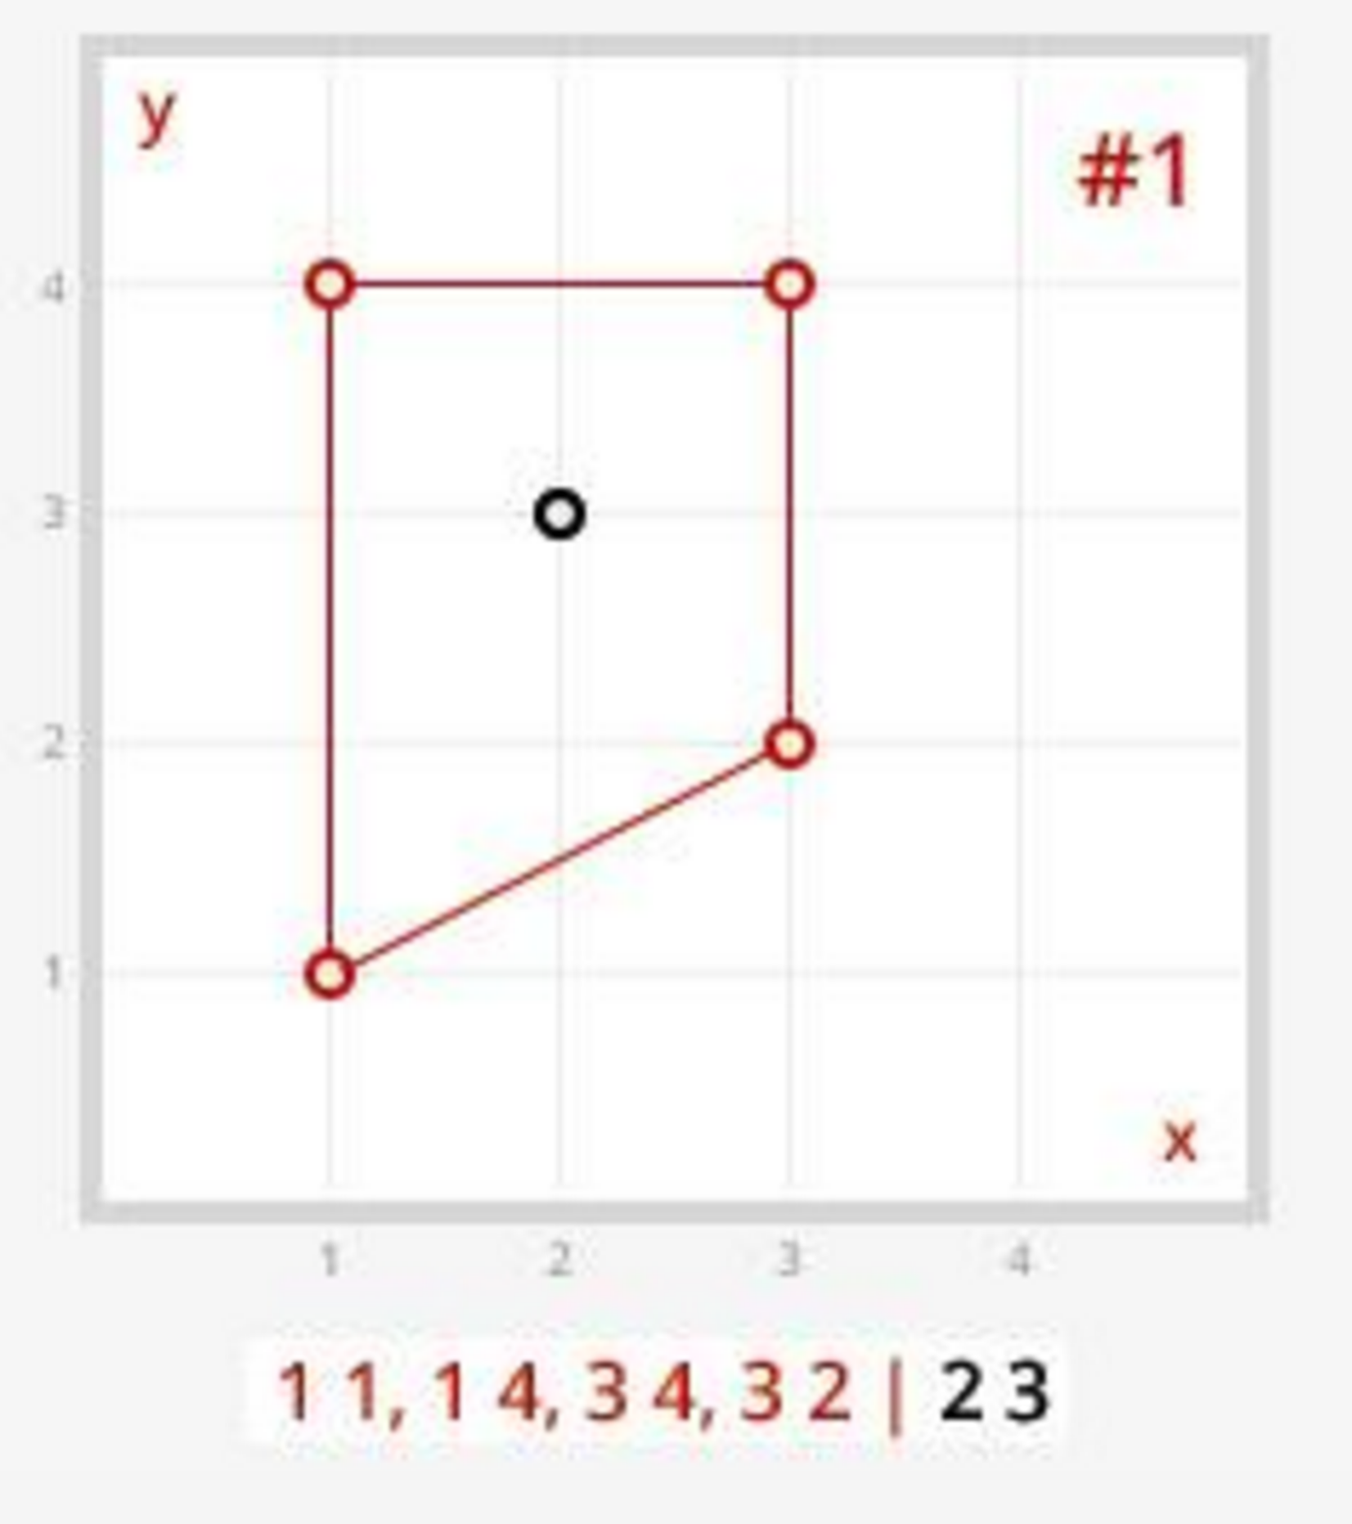
Creating the prison
Creating the first wall
(3,2)
(1,1)
Person
(2,3)
Side of wall
Clockwise: 2
Counter-Clockwise: 0

Slide 11
Prisoner or Citizen?
Side of wall
Clockwise: 2
Counter-Clockwise: 0
If by the end of the prison creation, the person was equally to the Counter-Clockwise and Clockwise of the walls, then they are outside of the prison
Person is a Prisoner!

Slide 12
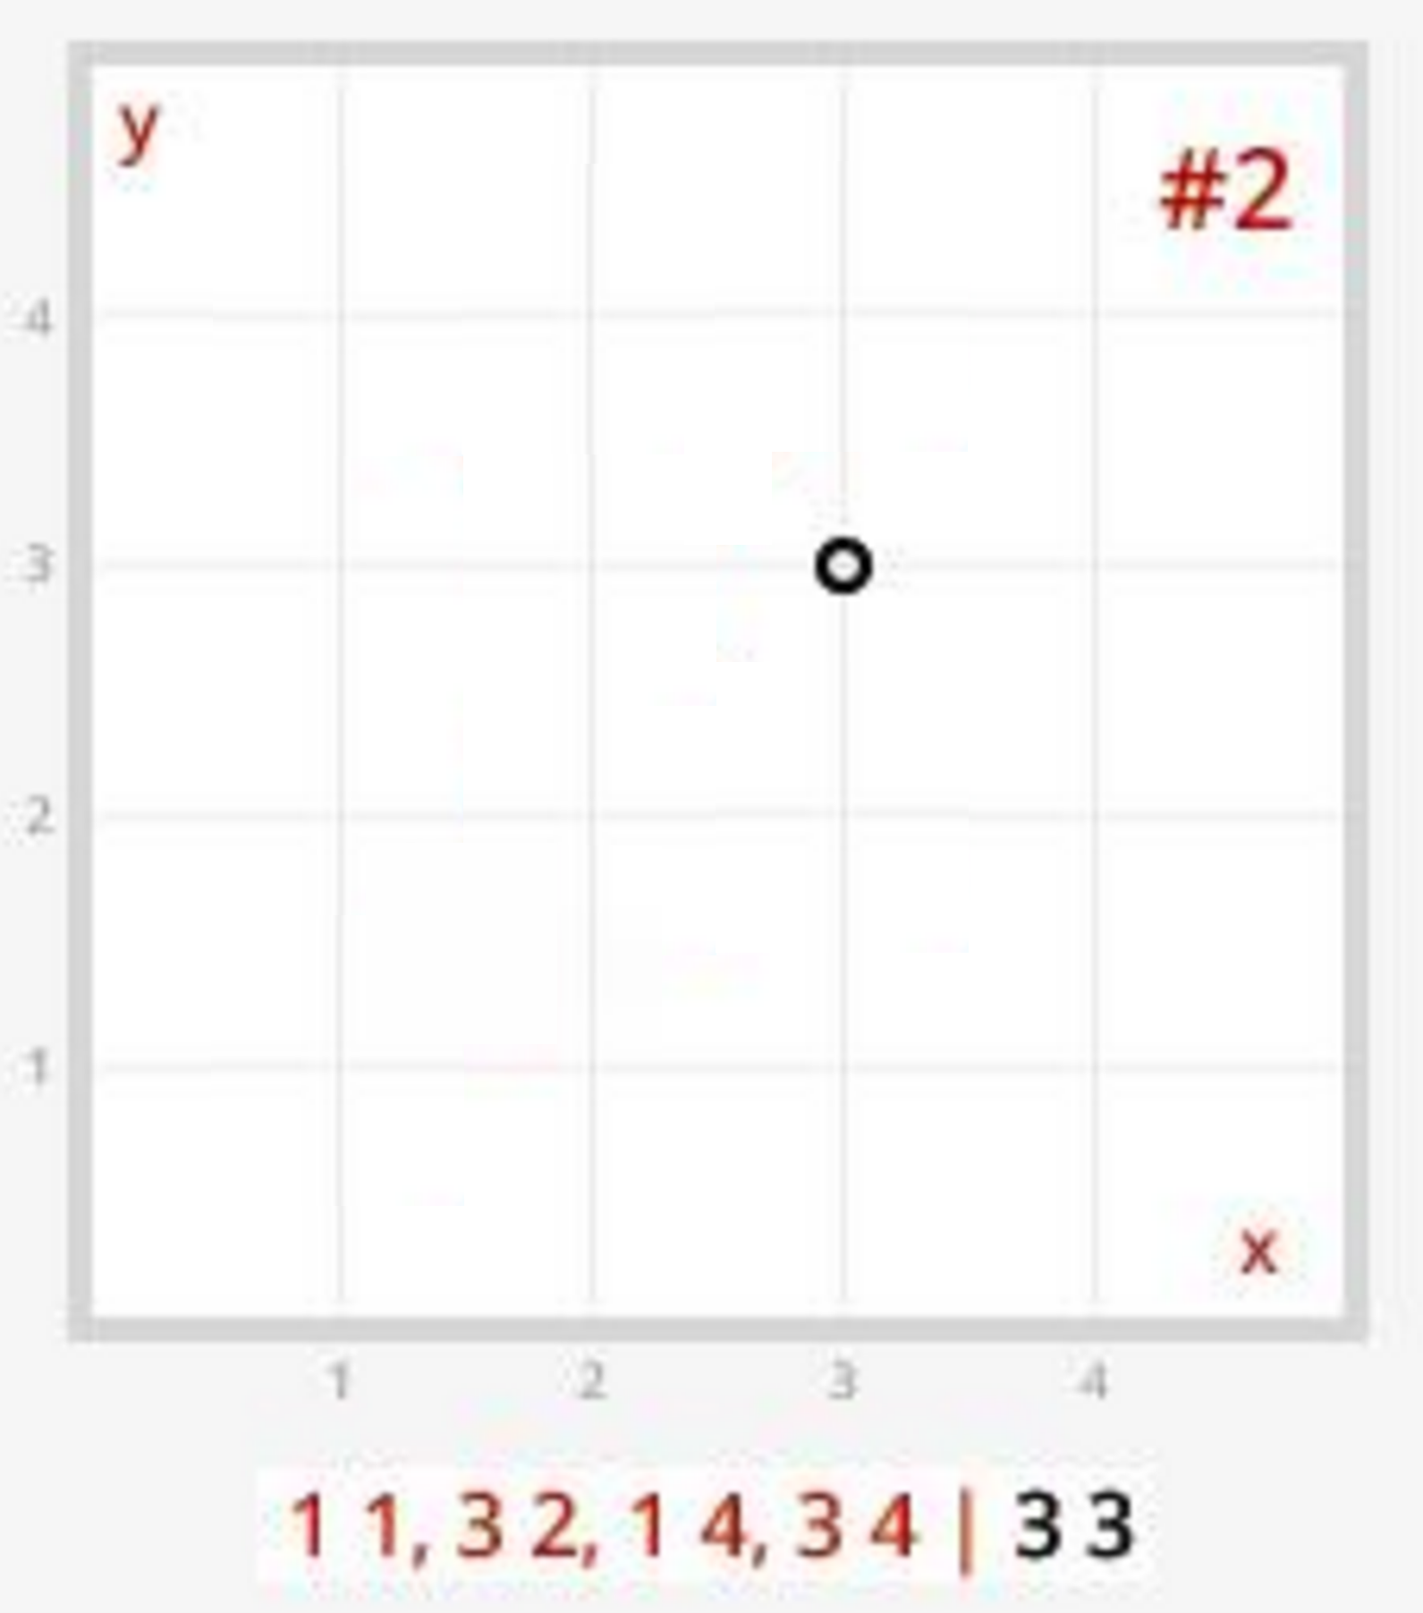
Creating the prison
Creating the first wall
(1,1)
(3,2)
Person
(3,3)
Side of wall
Clockwise: 0
Counter-Clockwise: 0

Slide 13
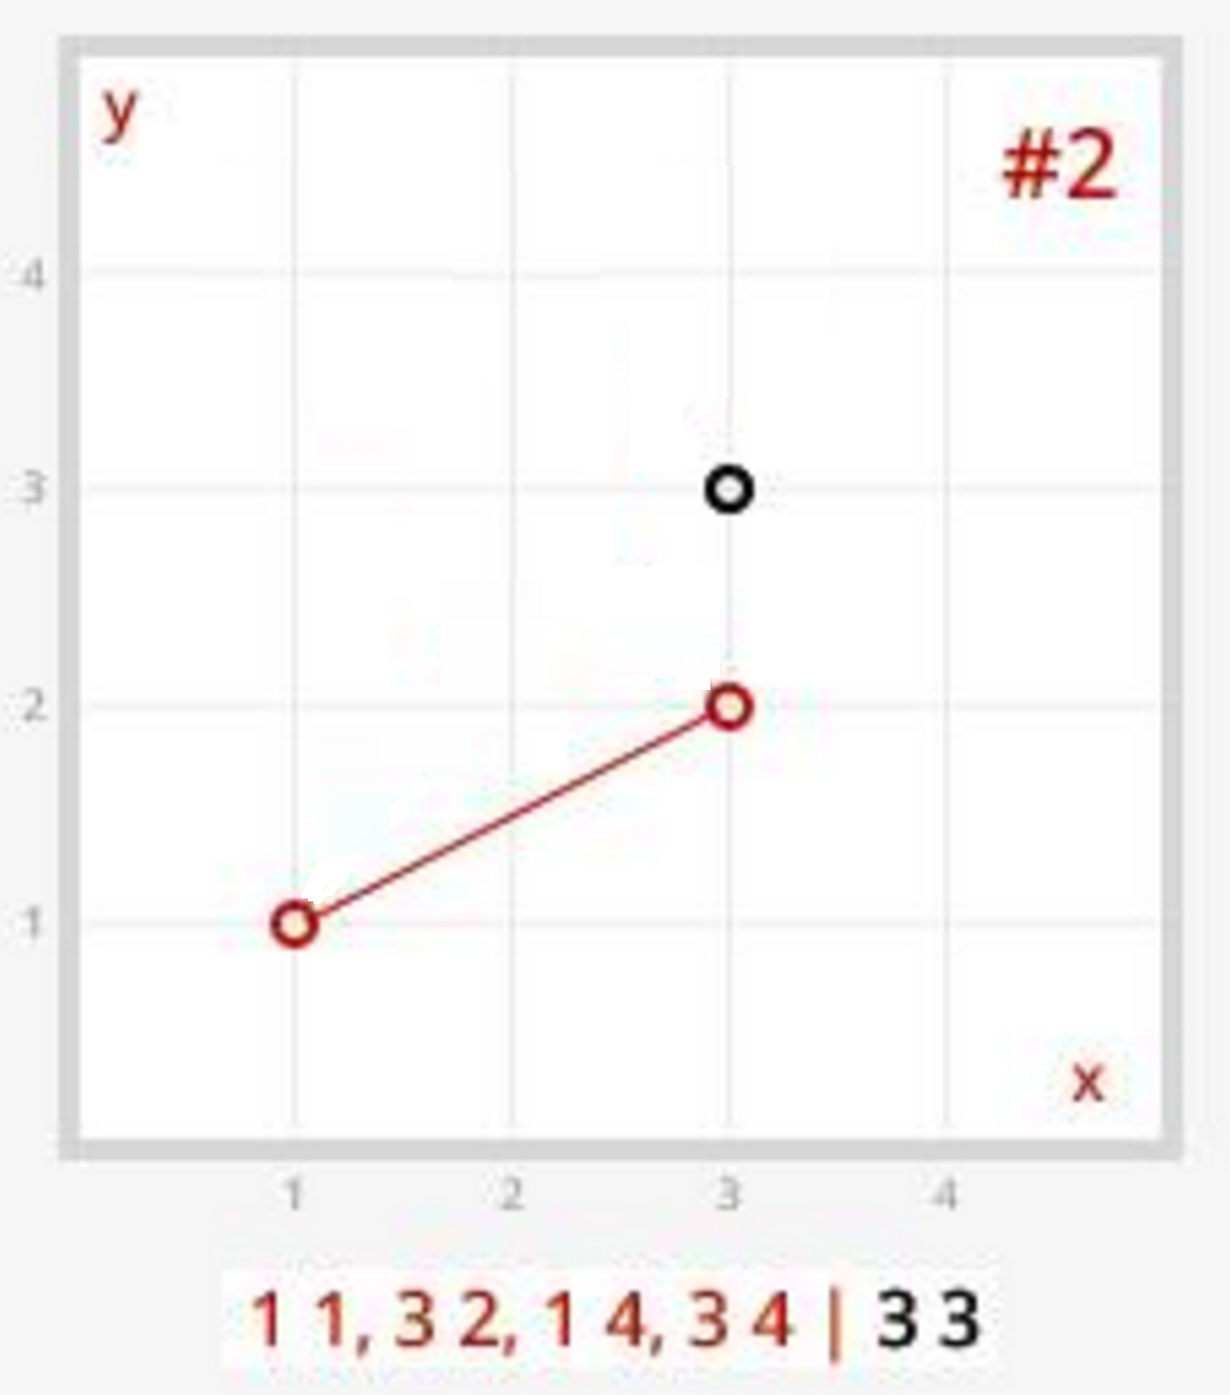
Creating the prison
Creating the first wall
(1,1)
(3,2)
Person
(3,3)
Side of wall
Clockwise: 0
Counter-Clockwise: 0

Slide 14
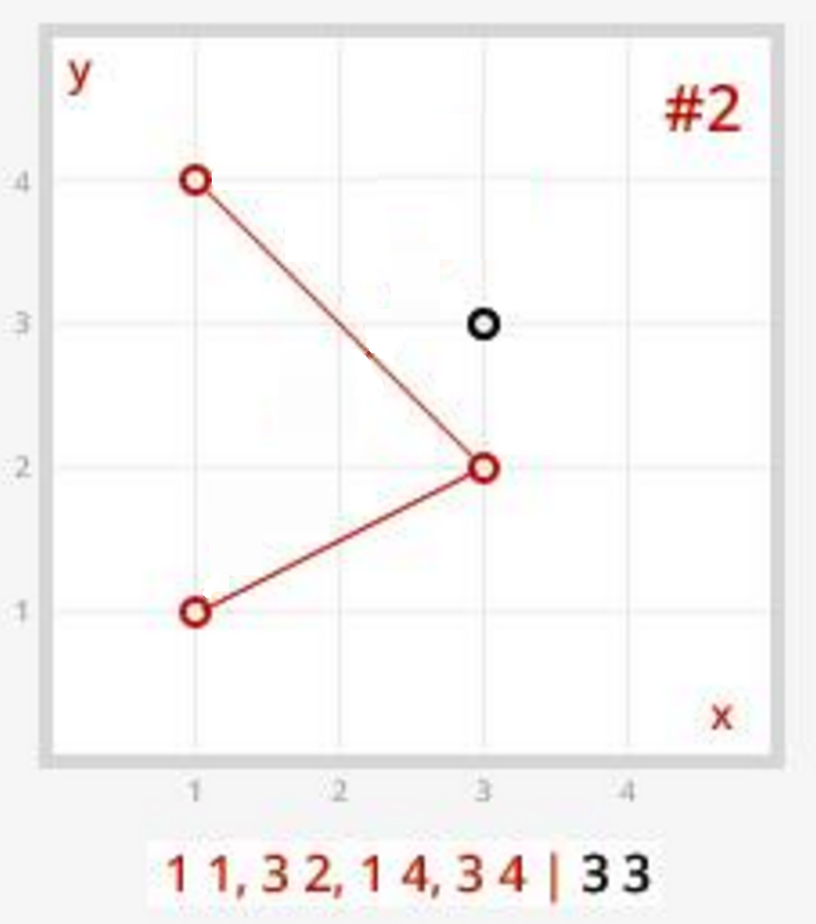
Creating the prison
Creating the first wall
(3,2)
(1,4)
Person
(3,3)
Side of wall
Clockwise: 0
Counter-Clockwise: 0

Slide 15
Creating the prison
Creating the first wall
(3,2)
(1,4)
Person
(3,3)
Side of wall
Clockwise: 1
Counter-Clockwise: 0

Slide 16
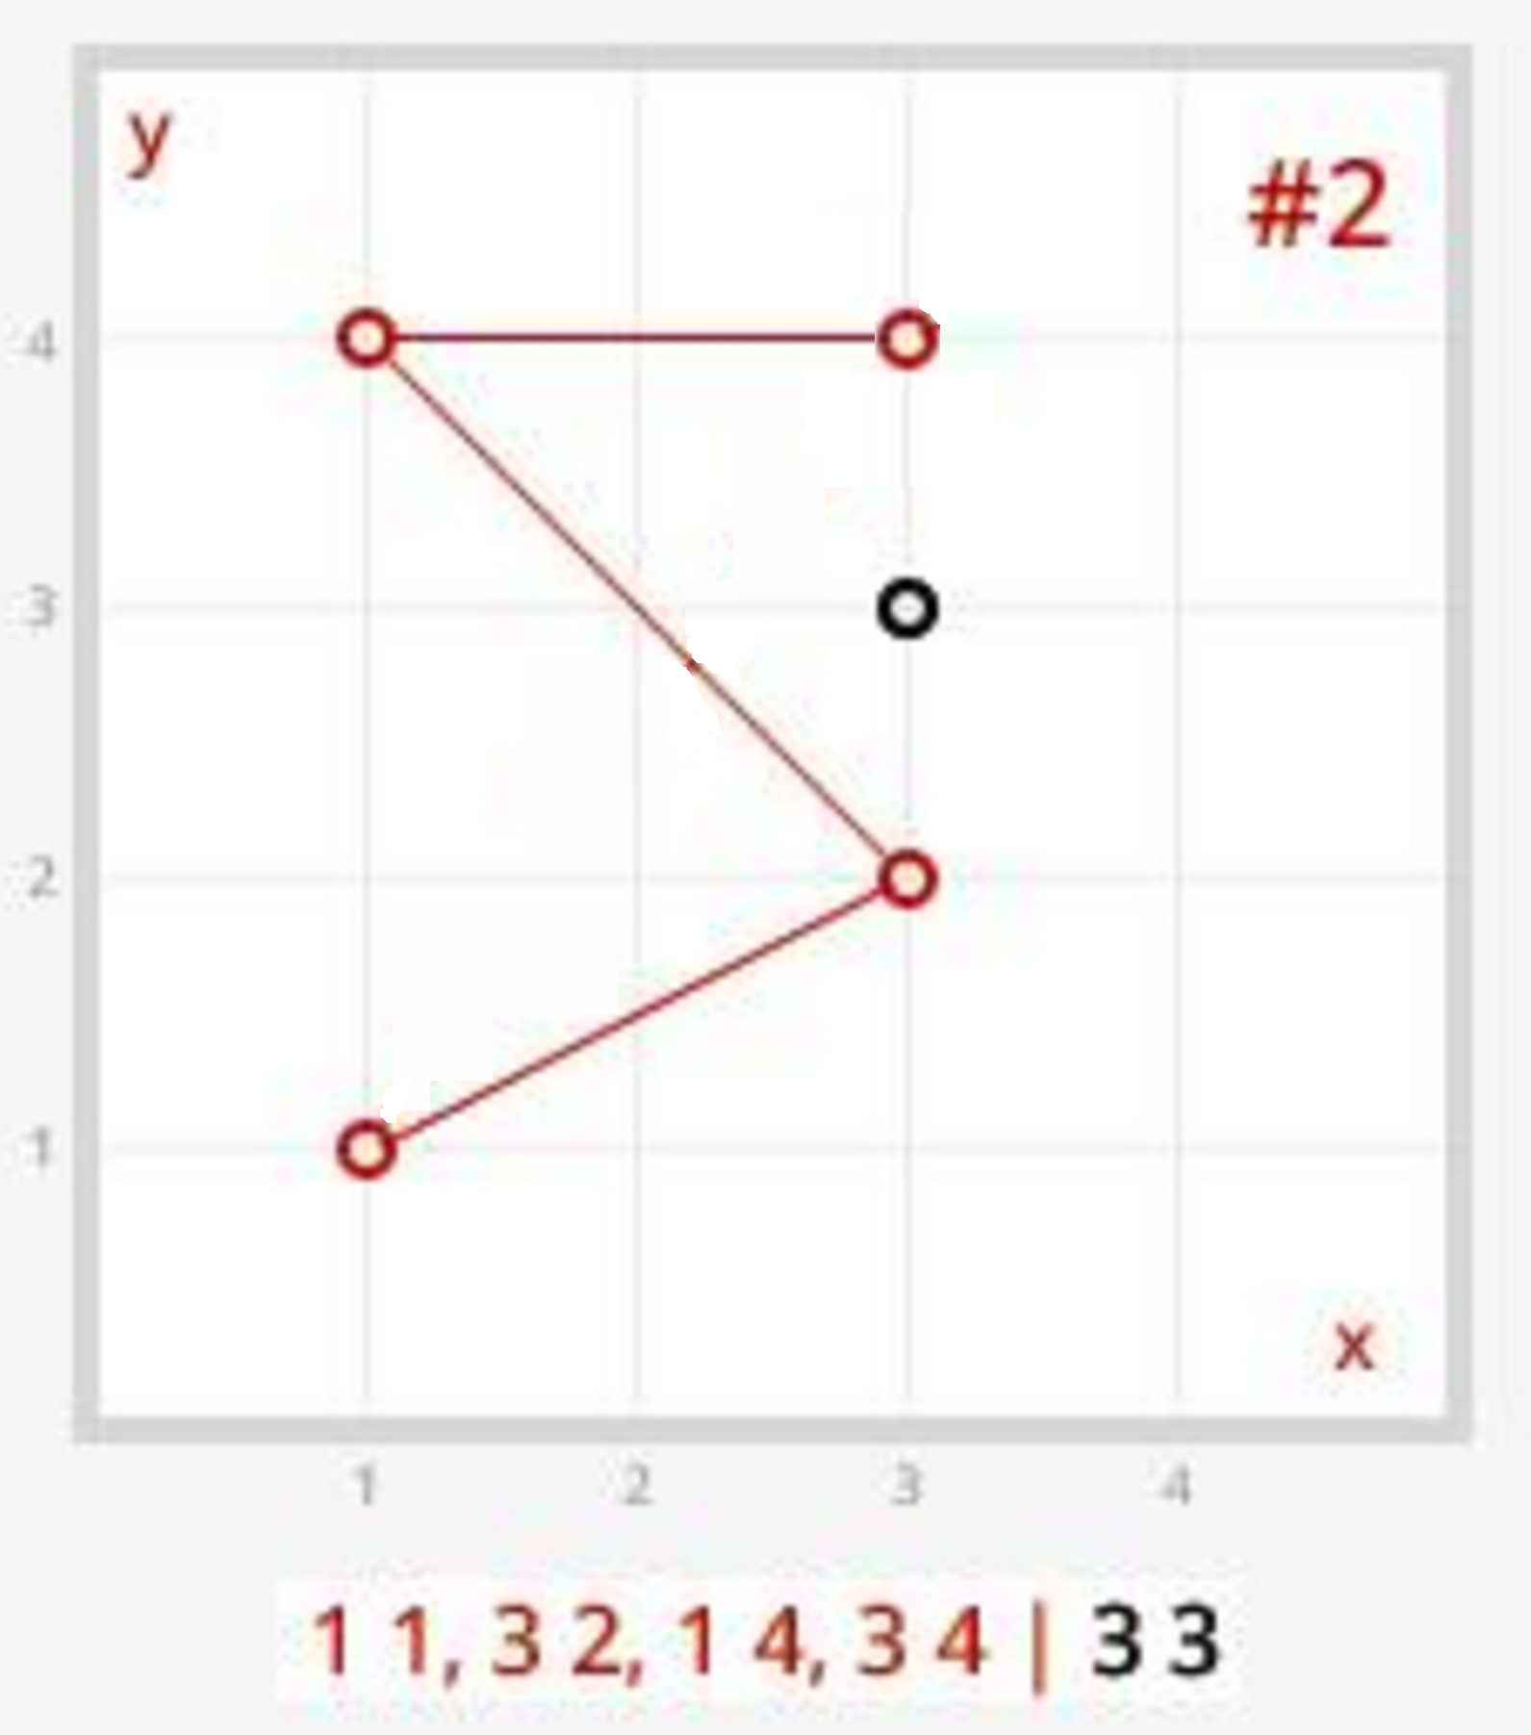
Creating the prison
Creating the first wall
(1,4)
(3,4)
Person
(3,3)
Side of wall
Clockwise: 1
Counter-Clockwise: 0

Slide 17
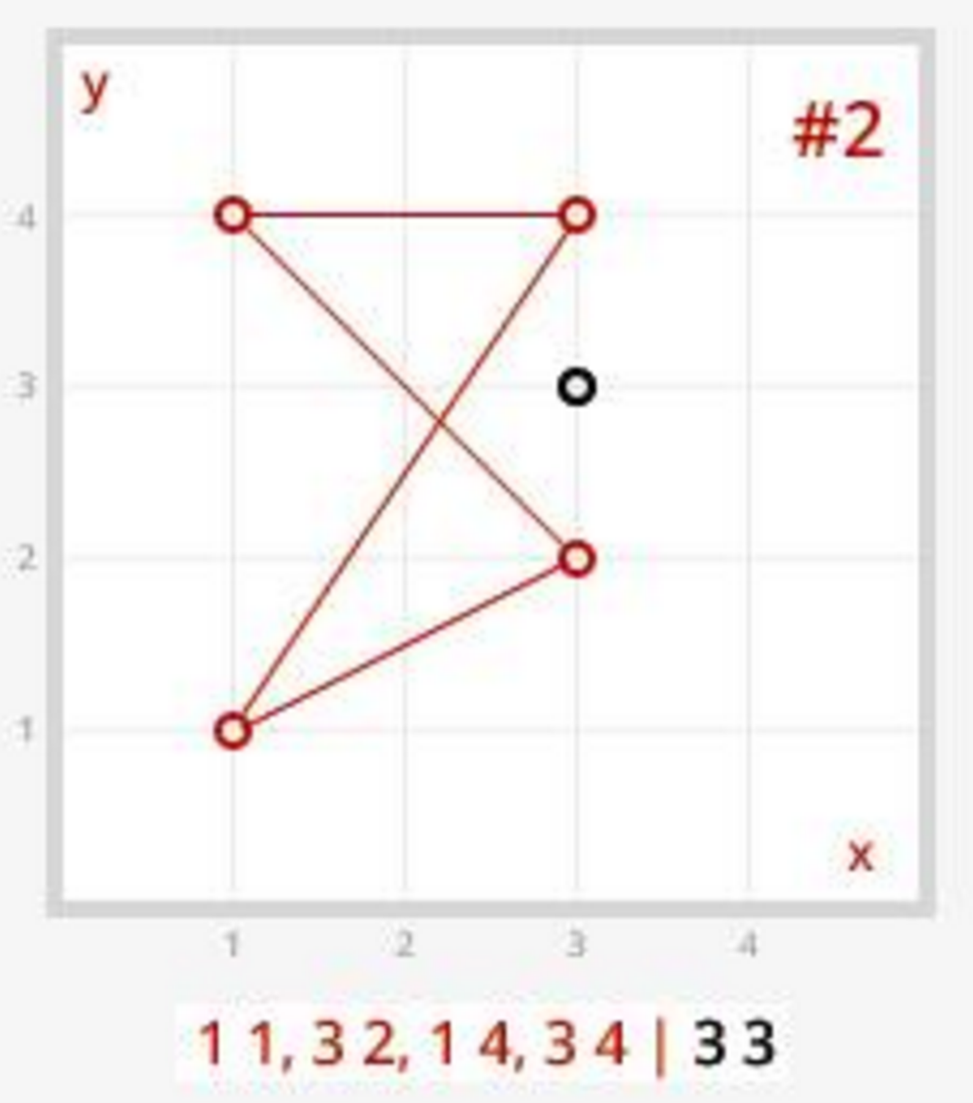
Creating the prison
Creating the first wall
(3,4)
(1,1)
Person
(3,3)
Side of wall
Clockwise: 1
Counter-Clockwise: 0

Slide 18
Creating the prison
Creating the first wall
(3,4)
(1,1)
Person
(3,3)
Side of wall
Clockwise: 1
Counter-Clockwise: 1

Slide 19
Prisoner or Citizen?
Side of wall
Clockwise: 1
Counter-Clockwise: 1
If by the end of the prison creation, the person was equally to the Counter-Clockwise and Clockwise of the walls, then they are outside of the prison
Person is a Citizen!

Slide 20
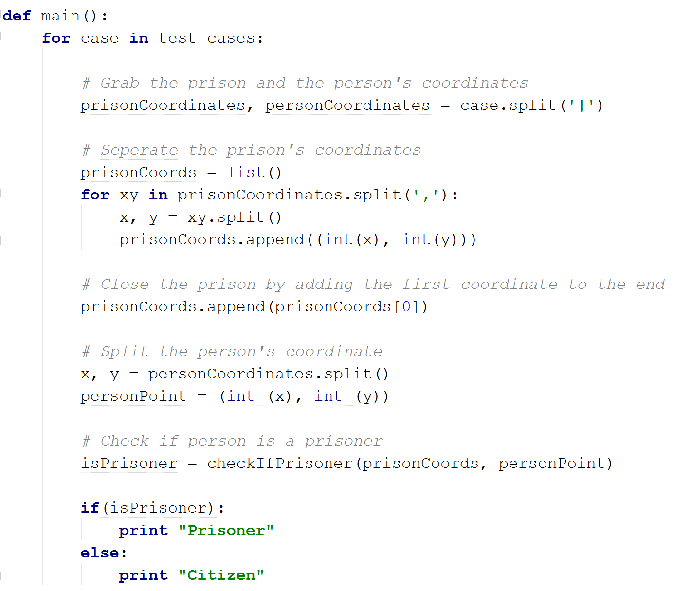
Code

Slide 21
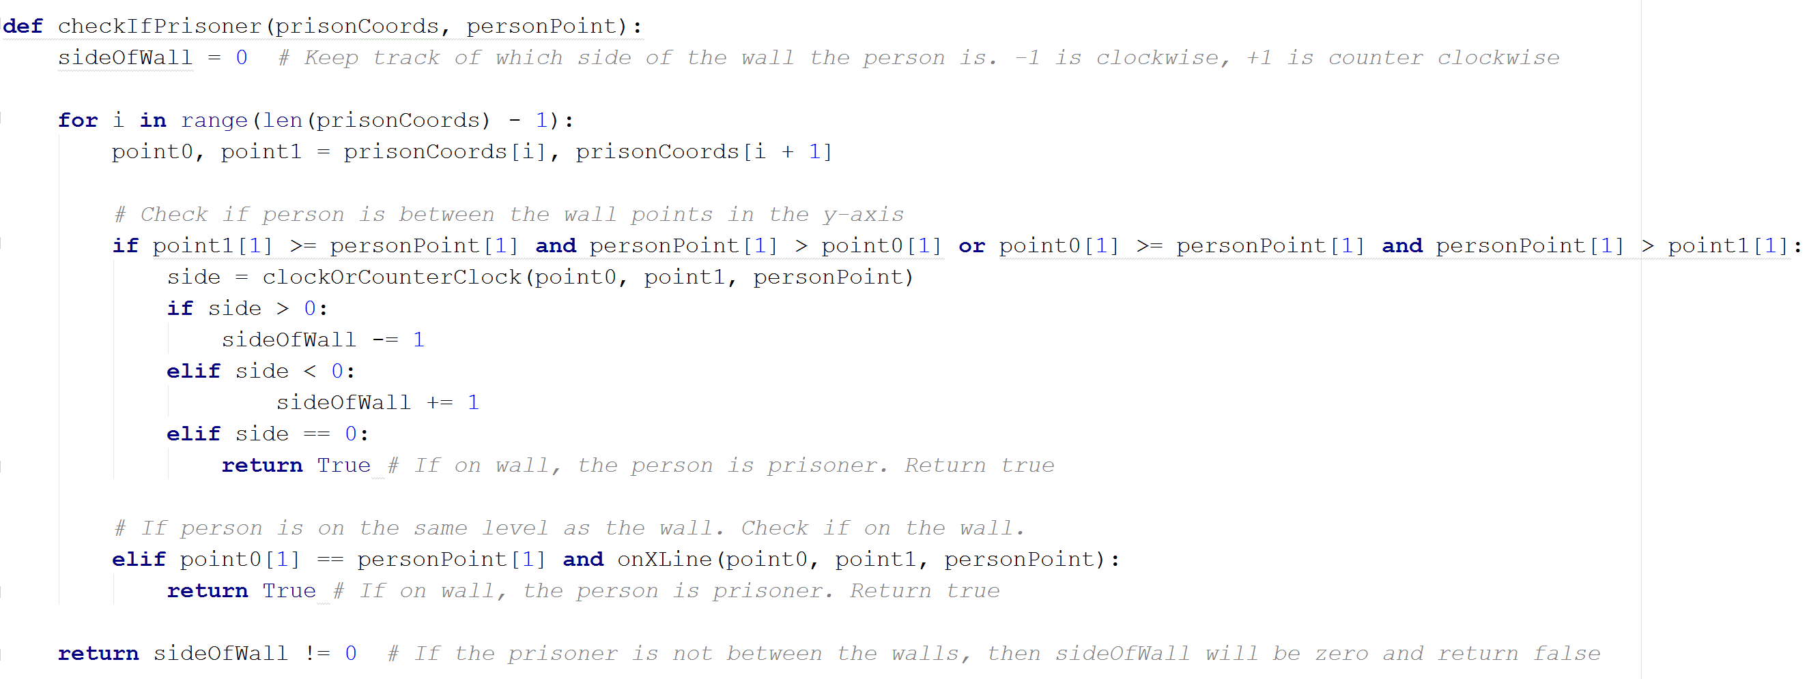
Code

Slide 22
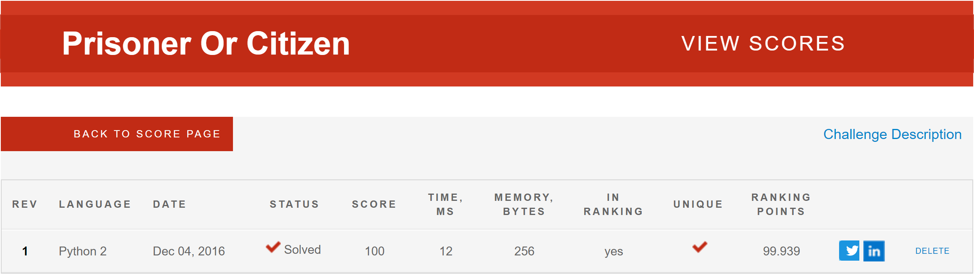
CodeEval

Slide 23
Thank you
Questions?

